Slide 1
Welcome to
Learning to read

Slide 2
you can Follow my blog at
Christiansforever.com

Slide 3
About the presenter
Faith Sheptoski-Forbush is a veteran school teacher, reading specialist, author and blog writer with a master’s degree in reading
Faith, together with her family, enjoys wholesome entertainment, travel and outdoor recreation

Slide 4
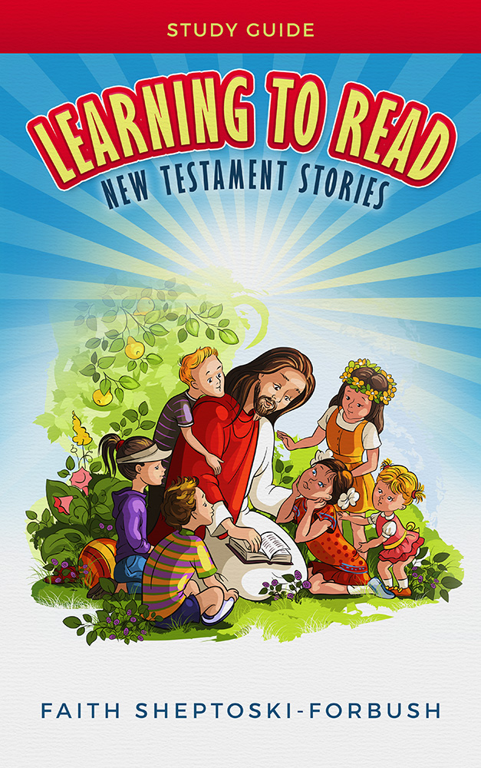
develop your child’s reading skills
What are some ways to do this?

Slide 5
What is one of the best ways to do this?
One way is to use the book Learning to Read: New Testament Stories

Slide 6

1st step: Read to your child
Read to your child out loud while your child listens to what you are reading
Instruct your child to look at each word in the book while you point to each word as you read

Slide 7
observational LEARNING
Your child will be learning to read by just listening to you read
Your child will be introduced to the sounds and recognition of new words in context

Slide 8

2nd step: Read to your child
Read to your child out loud a few words at a time while you point to the words you are reading
Instruct your child to read out loud while pointing to the same few words you just read

Slide 9
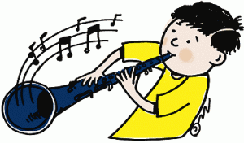
ROTE LEARNING
Your child will be learning to read by repeating what he heard
The literal definition for the word “rote” is the habitual repetition of something to be learned

Slide 10

Practice makes perfect
Remember hearing someone tell you the words practice makes perfect?
Your child needs to learn the role of a reader
Instruct him that he will be reading the same words several times so he gets better at it

Slide 11
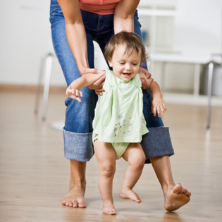
Practice makes perfect
You can use the analogy of a baby that takes his first few steps and falls down until he walks without falling down
Each time your child practices he will get better at it until he becomes perfect in reading those new words

Slide 12

Whole word strategy
This is also known as “Sight Word” or “Look and Say” methodology
Text such as “The Cat in the Hat” uses this method of learning to read

Slide 13
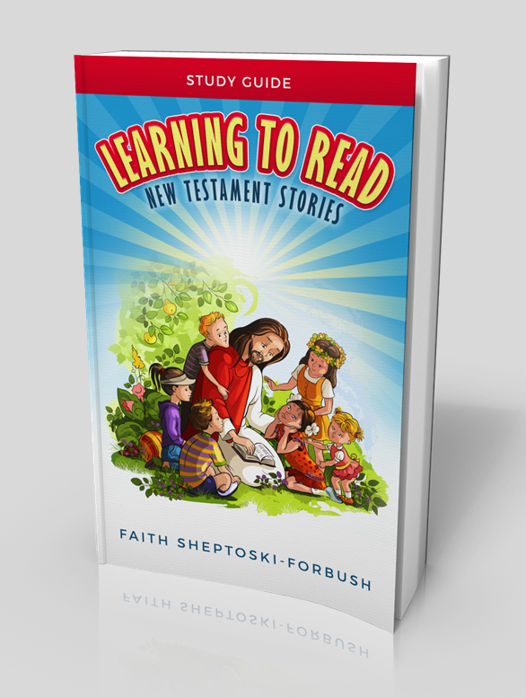
For example
In the book, Learning to Read: New Testament Stories, the words in bold are the new vocabulary words
“An angel told Joseph that Mary was going to have a baby.”
The new vocabulary words are angel and baby

Slide 14
Application of strategy
Learning to Read: New Testament Stories is designed for children, homeschoolers, or ESL learners who will improve their reading skills with new vocabulary words
They will also enjoy reading this book, either as bedtime stories or just for fun

Slide 15

Application of strategy
A good friend of mine bought the book, Learning to Read: New Testament Stories, for a baby shower gift
Another person gave it to a child as a quiet book during church services

Slide 16
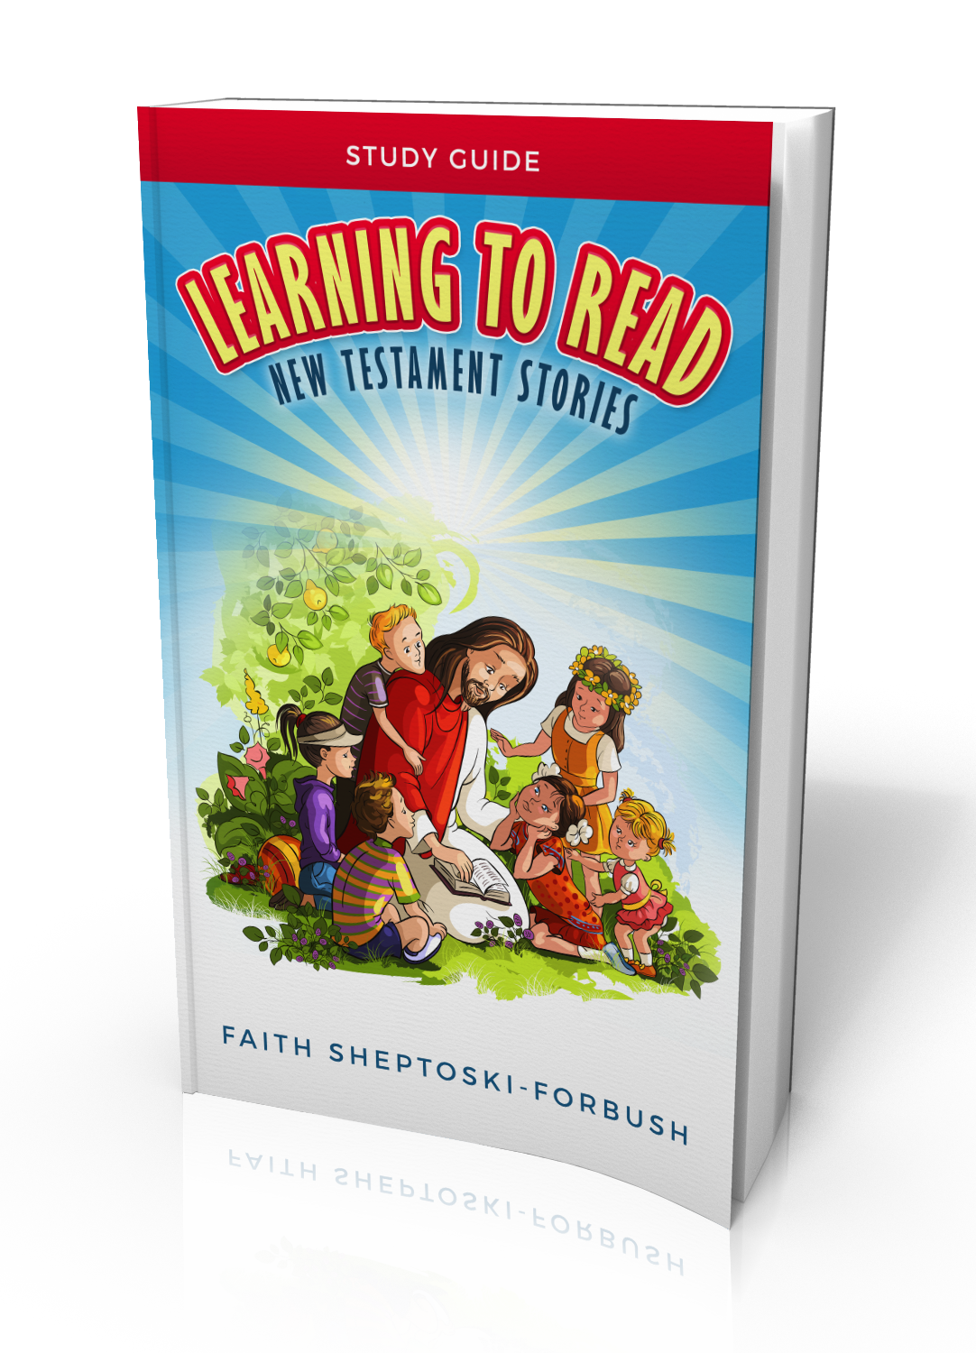
FURTHER develop your child’s reading skills
What are some additional ways to do this?

Slide 17
What is one of the best ways to do this?
One way is to use the book Learning to Read: New Testament Stories Study Guide

Slide 18
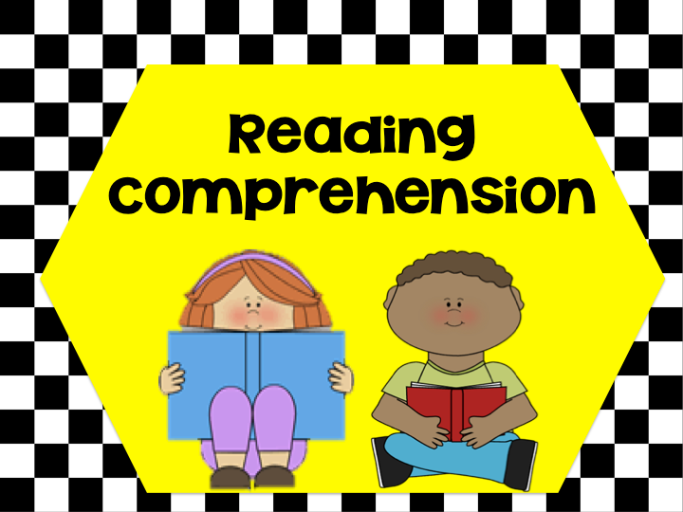
Comprehension skills
There are best practices to help your child build his or her comprehension skills
One such practice includes using prediction exercises in your homeschooling program

Slide 19
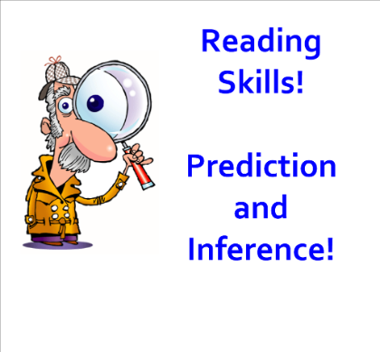
Prediction exercises
What exactly is a prediction exercise?
Why is a prediction exercise important in the reading process?

Slide 20

MAKING PREDICTIONS
It has been said that making predictions is a basic reading skill that requires higher level thinking
Higher level thinking is necessary for your child to progress from short term learning to long term learning

Slide 21
PREDICTION EXERCISE
In the prediction exercise your child must make an inference based on the information that he or she reads
Eventually all good readers learn how to make predictions based on textual evidence

Slide 22
PREDICTION EXERCISE
An effective prediction exercise allows your child to refer to the text and to make a prognosis of future events
Ask the question: “Based on what you read, what do you think is going to happen?”

Slide 23
PREDICTION EXERCISE
An effective prediction exercise allows your child to utilize his prior knowledge
Your child’s prior knowledge is made up of skills, beliefs, and attitudes which influence how he interprets and organizes incoming information

Slide 24

Reading literacy standards
Prediction exercises are considered part of literacy standards
“Read closely to determine what the text says explicitly and to make logical inferences from it"
“Cite specific textual evidence when writing or speaking to support conclusions drawn from the text” (CCSS.ELA-Literacy.CCRA.R.1)

Slide 25
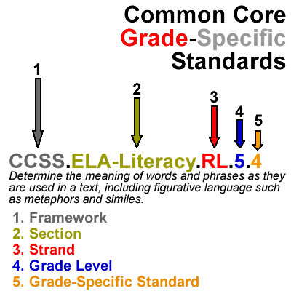
For “common core” supporters

Slide 26
Sample prediction exercise 1
Instructions: Before your child begins reading the story, instruct him to read the title. The title is Jesus. Instruct him to finish writing the Prediction Sentence below.
Prediction Sentence: The story will be about
____________________________________
____________________________________

Slide 27
Sample prediction exercise 1
Instructions: Next tell your child to read the story.
After he has finished reading, ask him if the story talks about the topic he predicted it would talk about.

Slide 28
Sample prediction exercise 1
Instructions: Instruct him to finish the After Prediction Sentence below. This gives your child focus before, during, and after reading.
After Prediction Sentence: The story was about
____________________________________
____________________________________

Slide 29

Main idea
You might have heard someone ask, “Hey what’s the idea”?
What exactly is the main idea?
Why is the main idea important in learning how to read?

Slide 30

MAIN IDEA
It has been said, that the main idea is nothing more or less than the general meaning the author wants his sentence to carry to the reader
The main idea is the purpose of the sentence

Slide 31
MAIN IDEA
We are starting at the very beginning here and want to focus on the main idea in each sentence
A topic is the subject that is being talked about

Slide 32
MAIN IDEA STRATEGIES
In order to become a better reader your child needs to know how to identify the main idea of each sentence
A good strategy in learning how to identify the main idea is to summarize each sentence

Slide 33

Summarizing strategy
When your child summarizes a sentence, he gives a condensed version of what he just read
In the summary, he refers to the author’s key ideas

Slide 34
Summarizing strategy
Another strategy is to assign your child to silently read 5-10 sentences in the Bible
Next instruct your child to write a summary of each sentence

Slide 35
Summarizing strategy
The next strategy includes instructing your child to read 5-10 sentences in the Bible out loud
After each sentence is read, ask your child to verbally summarize each sentence

Slide 36
Summarizing strategy
The strategy of summarizing helps you check your child’s understanding of the main idea
If your child does not seem to comprehend a sentence, you can provide context clues

Slide 37
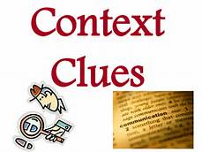
Context clues
Sometimes an author gives context clues or hints to help define a difficult or unusual word
The clue may appear within the same sentence

Slide 38

Context clues
Look at this sentence: The big dog, which liked to wag his tail, lost his collar
The descriptive context clues for the unknown word “dog” are: “wag his tail”, and “collar”

Slide 39
Context clues
Look at this sentence: And when he had fasted forty days and forty nights, he was afterward an hungred (Matthew 4:2)
The descriptive context clue for the unknown word “hungred” is: “fasted forty days and forty nights”

Slide 40

EXPLICIT QUESTION
An explicit question will give your child practice in identifying what the author is talking about
An explicit statement is something that is clear and fully expressed

Slide 41

EXPLICIT QUESTION
Basically the answer to the explicit question is found by recalling what one has read in the text
Reading comprehension skills are based on a student’s ability to pull information from text

Slide 42
IMPLICIT QUESTION
An implicit question will also give your child practice in identifying what the author is talking about
An implicit question will also build his comprehension skills by asking him to connect ideas

Slide 43
IMPLICIT QUESTION
The answer to the implicit question is achieved by finding out what the author is suggesting in the story
Questions about why things happen in a story are often implicit comprehension questions

Slide 44
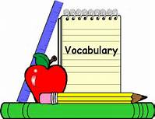
Vocabulary words
Vocabulary word exercises give your child practice in matching up the correct definition with the appropriate vocabulary word
This builds your child’s vocabulary skills

Slide 45

Vocabulary words
One easy way is to use flash cards and memorize definitions
This is an effective memory aid tool
There are also digital aid flash cards for college students

Slide 46
Vocabulary words
You can shuffle the order of the flash cards to prevent your child from merely memorizing the order of definitions
Reverse the cards so the definitions are seen first allowing your child to recall the original vocabulary word

Slide 47

What’s out there?
One free internet site is called Understood.org which helps children with learning disabilities
Khanacademy.org is a great free site for children from kindergarten through college

Slide 48
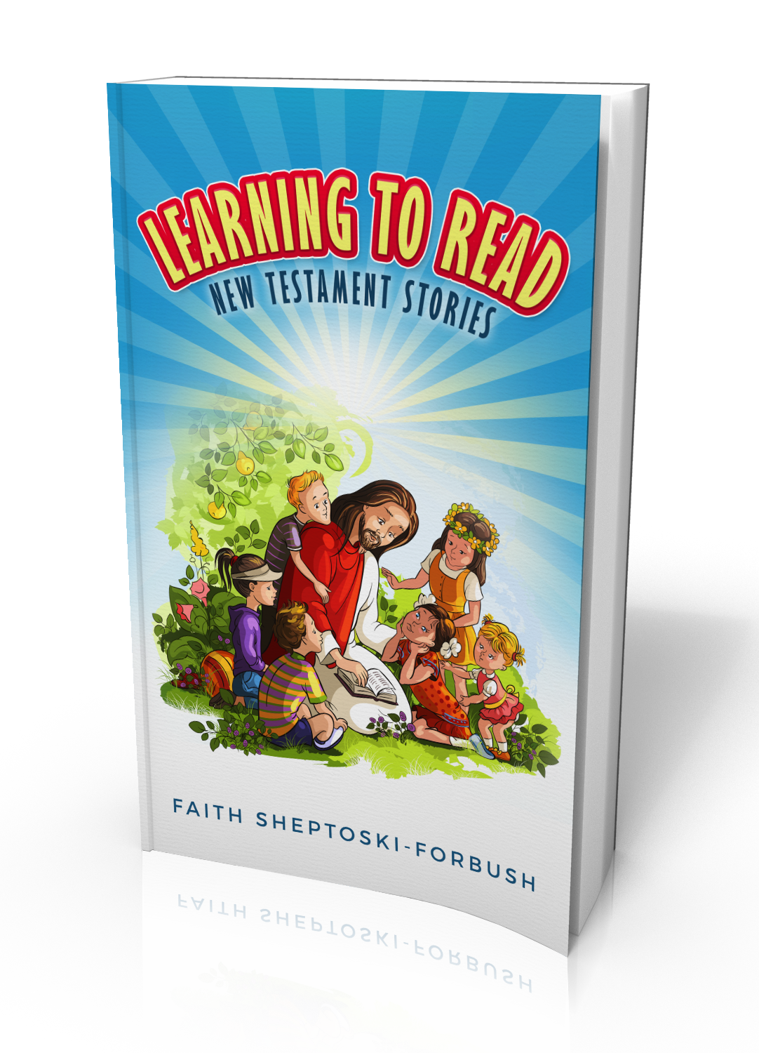
develop your child’s reading skills
Learning to Read: New Testament Stories

Slide 49
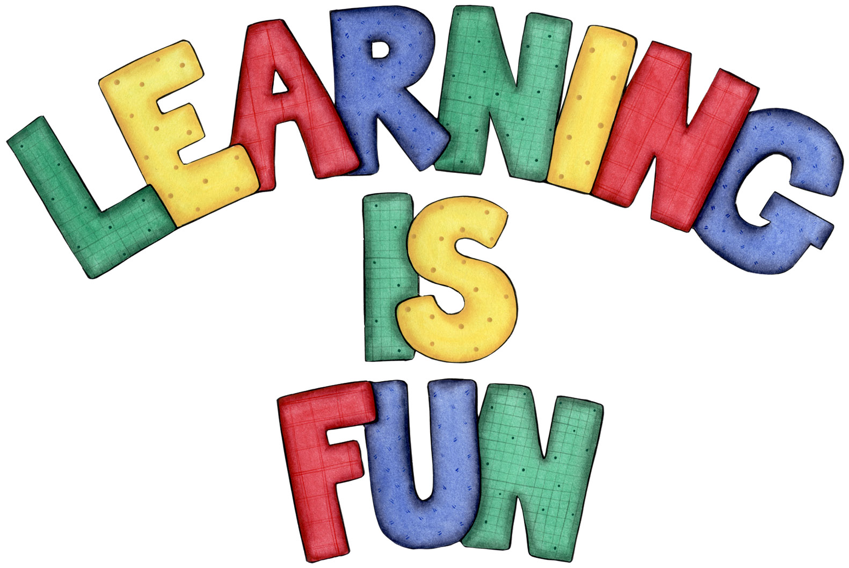
Learning to read
New testament stories
This book is designed for children, homeschoolers, or ESL learners who will improve their reading skills with new vocabulary words
They will also enjoy reading this book, either as bedtime stories or just for fun

Slide 50
Further develop your child’s reading skills
Learning to Read: New Testament Stories Study Guide

Slide 51
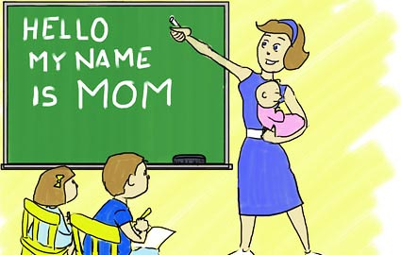
Learning to read new testament stories study guide
This book is designed for children, homeschoolers, or ESL learners who will improve their reading skills with easy-to-follow activities for each story

Slide 52

Learning to read new testament stories study guide
They will achieve improved literacy with the prediction, vocabulary, comprehension, main idea, and reasoning exercises found in this book
The study guide is intended to be used with the companion reader

Slide 53

Learning to read new testament stories study guide
Together these two books will enhance your reading development experience

Slide 54
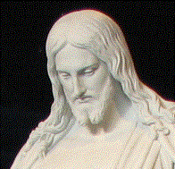
For Free educational resources
Follow us on Facebook and Twitter, or visit us at ChristiansForever.com

Slide 55
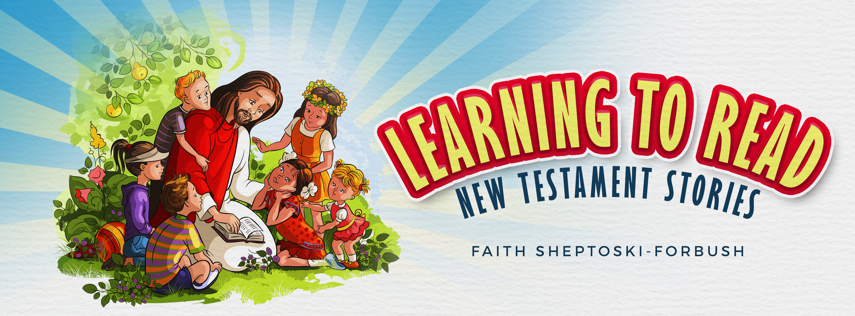
Thanks for coming

